Slide 1
A Research of an Image-based Password System as an Alternative to a Text-based Password System
Mohammad Forhad Hossain

Slide 2
Outline
Introduction
Objectives
Secondary research
-Background
-Literature review
-Creating and storing passwords
-How password save in the database
Primary Research
-Implementation
-Experiments
-Interviews
Results
-Findings
Conclusion

Slide 3
Introduction
Over 3 billions of passwords leaked in 2016.
More then half (55%) of users use same password for most of their accounts.
26 % of users use simple passwords, such as their birthdays or names
In our research we found that, Image based password system give more security as compare to text-based password system.

Slide 4
Objectives
Achieve a password complexity which is secure.
Make sure the password is hashed in case the database is compromised.

Slide 5
Background
Literature review
-very limited number of research in the area
-main advantages of image-based passwords are, that images are easier to remember than text-based passwords
- we find out what password complexity means
-what makes password system secure.
NIST recomments for Creating password
-Adding numbers, Capital Letters, Special Characters, password length at least 8
NIST recomments for storing a password
- Use secure hash algorithm
- Password should be salted and hashed with a key derivation function
- Salt should use at least 32 bit

Slide 6
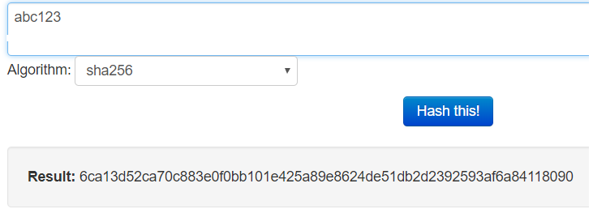
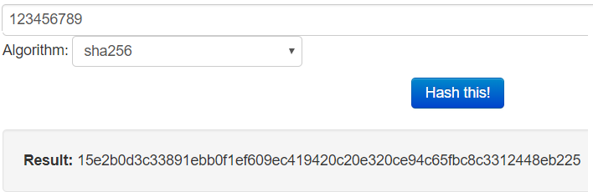
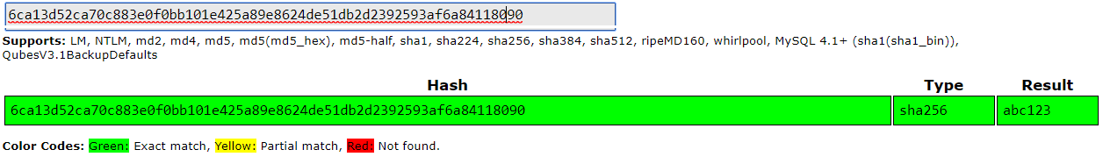
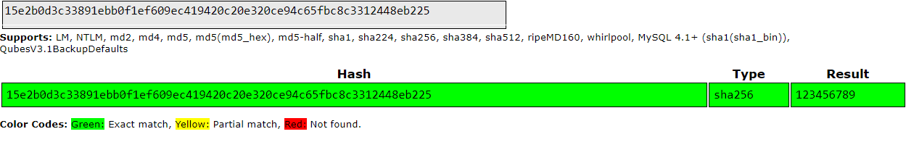
How easy to break week text-base password
Reference:
For Hash: https://www.tools4noobs.com/online_tools/hash/
For Crack password: https://crackstation.net/

Slide 7
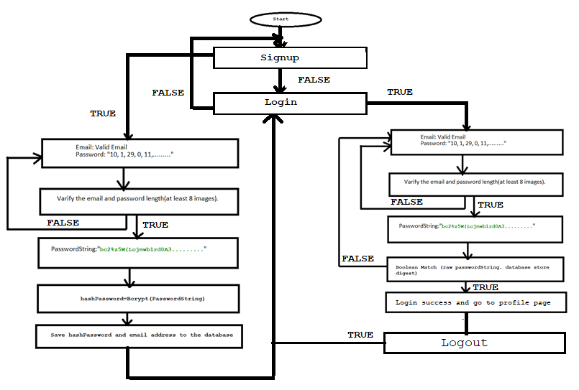
Implementation
Java spring boot
Bcrypt Algorithm
Knuth Fisher Yates algorithm for shuffling the images
Fig: How Authentication system works

Slide 8
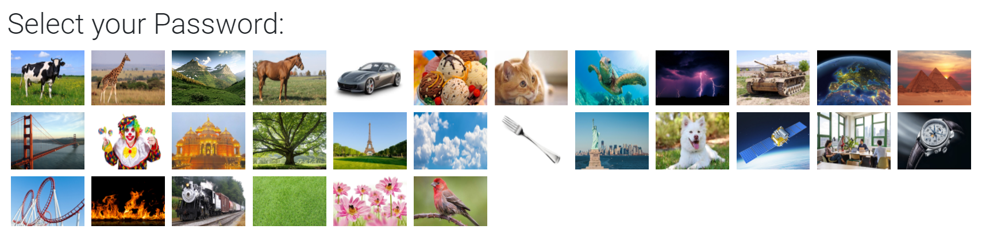
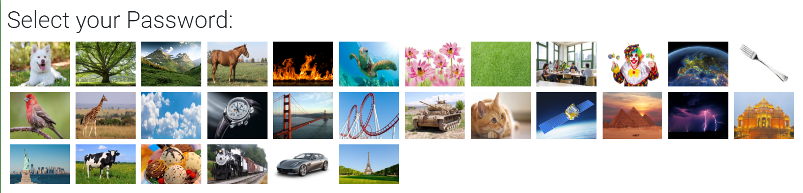
Image-based password
We used Knuth Fisher Yates algorithm for shuffling the images

Slide 9
Bcrypt ”Hash” stored in the Database
$2a$10$JozQv9pEcmSHNOB1CSkZbOq1AW3H6Cxvm1mEu1vZjH/UgX4ly69.C
"2a" defines version of bcrypt algorithm.
"10" defines the cost factor. So 2¹⁰ iterations of the key derivation function are used in the system.
The rest of the hash string includes the cost parameter, a 128-bit salt (base-64 encoded as 22 characters)
184 bits of the resulting hash value (base-64 encoded as 31 characters)

Slide 10
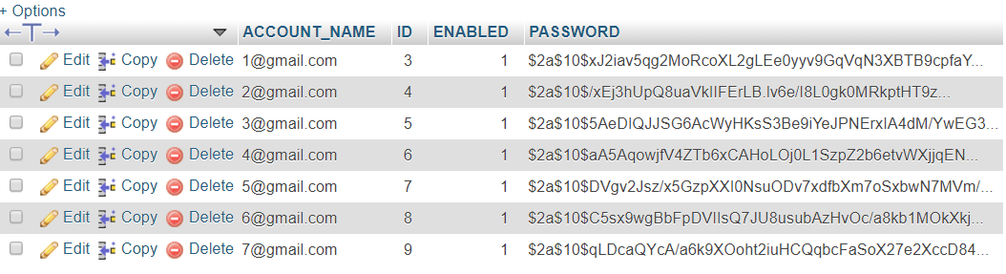
Hashed Password Save in Database

Slide 11
Experiment
Experiment on 10 people
Our users had different ages and gender
User create an account with email address and at image 8 image as a password.
We also tell them to create a text based password.
Password has to be securely constructed (upper case, special character, number)
User also not allow to use old / previous used password
Both text and image based password should be same length.
After 5 days we asked to the user this password again

Slide 12
Interviews
We interviewed around ten users, asking them what they think about the general usability of the image-based password system compared to a text based password system.
No of users | Description
8 | Eight image long password is too long to remember
10 | Login process is time consuming
6 | It is hard to make story for creating image based password
3 | Image-based password is better than text base password

Slide 13
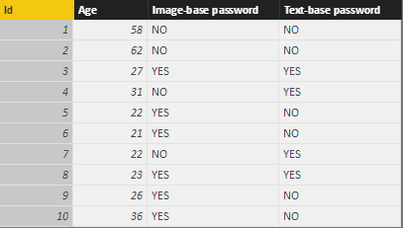
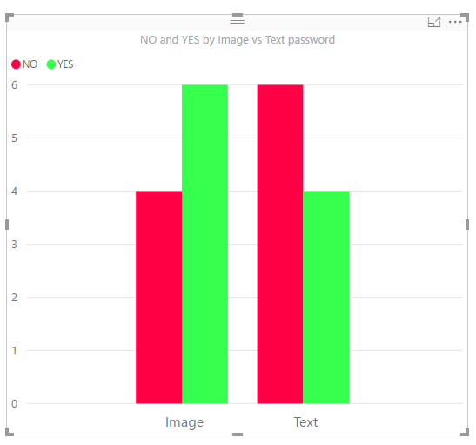
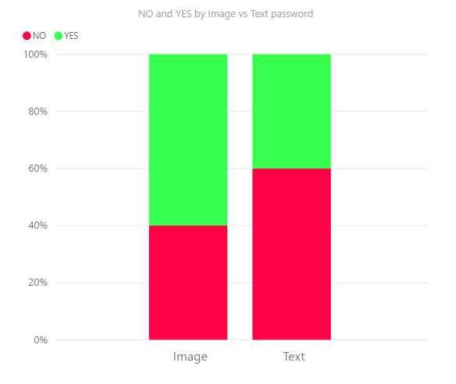

Findings
Remembered image password vs. text password

Slide 14
Crack password
Minimum password length is 8 images
Possible image combinations is 30⁸ = 656 100 000 000
Around 656.1 billions combinations
A modern CPU can calculate around 200 Bcrypt per second.
For crack one password it will take around 50 years
Time can be decrease if attacker use multiple parallel GPUs.

Slide 15
Conclusions
The security advantage of the image based password system is that we were able to construct a long secure text-based password.
In our experiment we found that most people could remember an image-based password as compare to text based.
Most of our users said that login process is slow.

Slide 16
Questions?????

